Slide 1
CVE-2017-16995
Elizabeth Hubbard, Daniel Elice

Slide 2

Vulnerability: CVE-2017-16995
“The check_alu_op function in kernel/bpf/verifier.c in the Linux kernel through 4.14.8 allows local users to cause a denial of service (memory corruption) or possibly have unspecified other impact by leveraging incorrect sign extension”[1].
Earlier versions of Linux, prior to version 4.14.8 utilize Berkeley Packet Filter (BPF). BPF is a way to perform packet filtering at the kernel level. There is also the Extended/enhanced Berkeley Packet Filter (eBPF). eBPF provides the ability to attach to almost any location in the kernel.
The verifier is used to determine if an eBPF function is safe or not. It has the job of blocking malicious programs.

Slide 3
Cause of Vulnerability
There is an improper arithmetic/sign-extension in the check_alu_op() function which is located in the verifier.c.
This improper arithmetic/sign-extension in the check_alu_op() function allows a malicious actor to bypass the BPF verifier, load BPF code, and create have unlimited read/write permissions to the kernel.

Slide 4
Two cases in the check_alu_op() function:
BPF_ALU64|BPF_MOV|BPF_K (load 32-bit immediate, sign-extended to 64-bit)
BPF_ALU|BPF_MOV|BPF_K (load 32-bit immediate, zero-padded to 64-bit);
Notes:
Check_alu_op() function’s purpose is to check the validity of the 32-bit and 64- bit arithmetic operations
BPF_ALU→ the alu instructions perform operations between the accumulator and index register or constant and store the result back in the accumulator

Slide 5
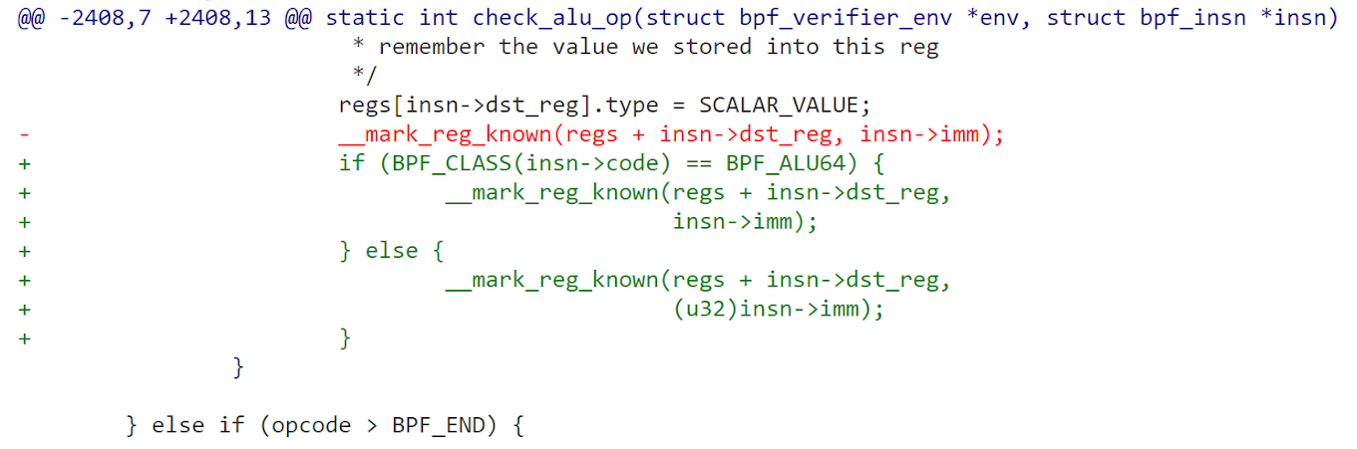
verifier.c
Notes:
Originally, only the line in red was implemented here.
The improper arithmetic made it possible for sign extension to occur in both cases. Sign extension is basically increasing the number of bits while keeping the number’s sign and value.
With the new fix, sign extension will only occur in the BPF_ALU64 (due to the if/else statement)
If… case: r1=r2, copy register state to dest reg

Slide 6

Exploit
int main(int argc, char **argv) { initialize(); hammer_cred(find_cred()); msg("credentials patched, launching shell...\n"); if(execl("/bin/sh", "/bin/sh", NULL)) { fail("exec %s\n", strerror(errno)); } }
Notes:
Three main functions: 1. initialize()
2. find_cred()
3. hammer_cred()

Slide 7
initialize()
Creates BPF map - Data structure consisting of key value pairs - Returns a file descriptor referring to the map with the specified parameters
int bpf_create_map(enum bpf_map_type map_type, int key_size, int value_size, int max_entries, int map_flags) { ... return syscall(__NR_bpf, BPF_MAP_CREATE, &attr, sizeof(attr)); }
mapfd = bpf_create_map(BPF_MAP_TYPE_ARRAY, sizeof(int), sizeof(long long), 3, 0);
Notes:
BPF maps→ created from userspace using the BPF system call. The BPF syscall returns a file descriptor for the map.
Once a map is created, elements can be accessed from userspace using the BPF system call
Maps are automatically deallocated once the user process that created the map terminates.

Slide 8
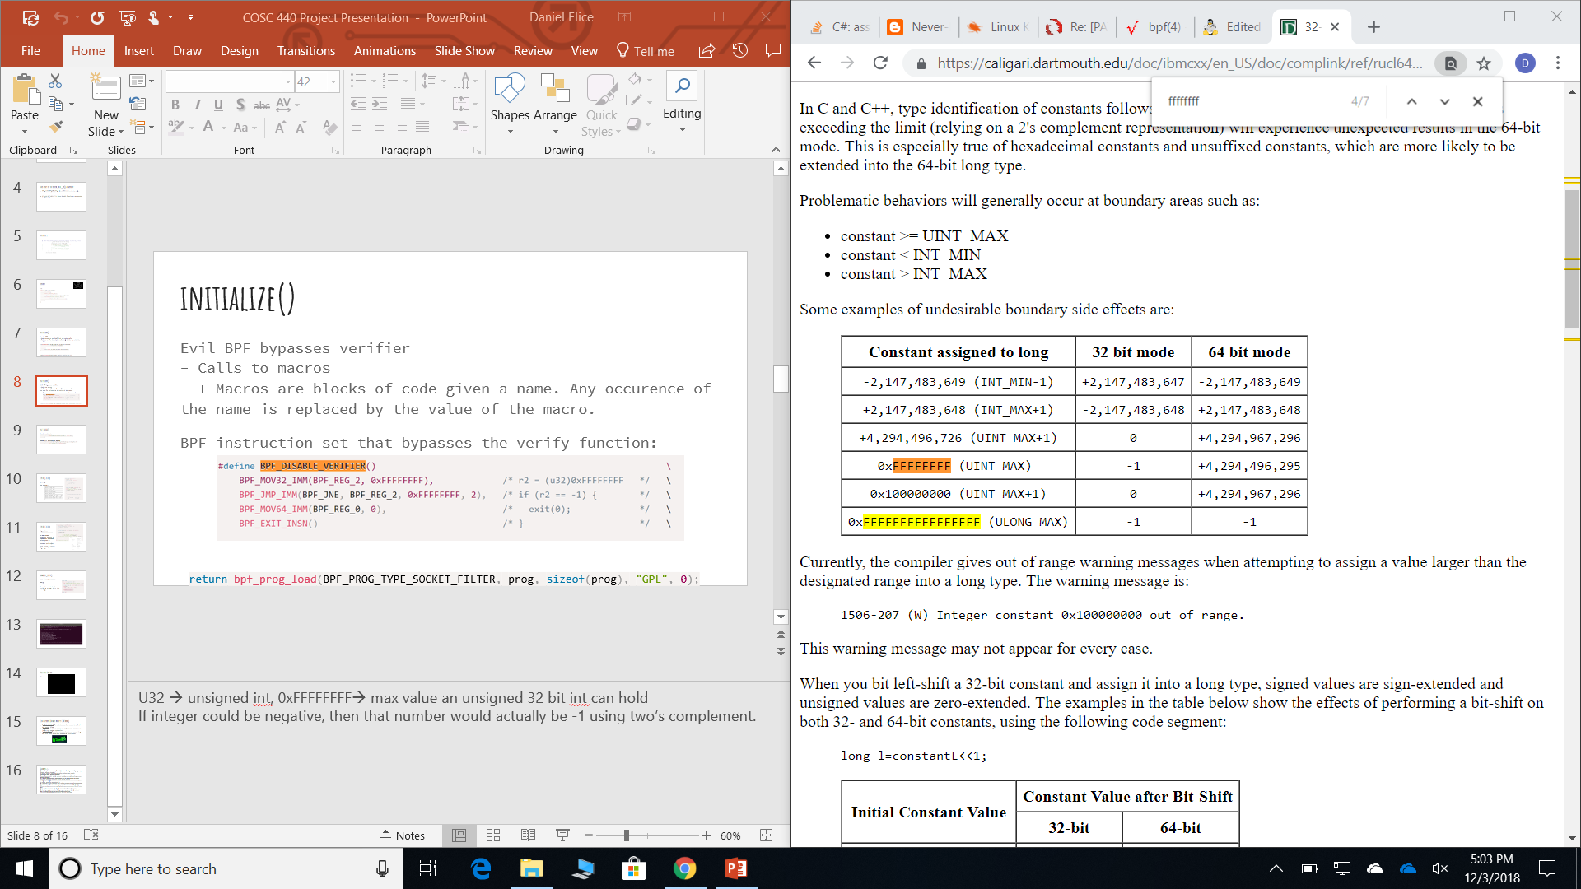
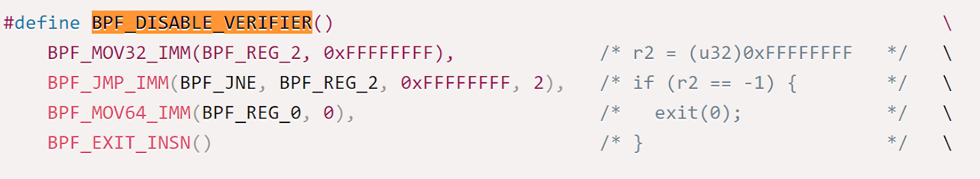
initialize()
Evil BPF bypasses verifier - Calls to macros + Macros are blocks of code given a name. Any occurence of the name is replaced by the value of the macro.
BPF instruction set that bypasses the verify function:
return bpf_prog_load(BPF_PROG_TYPE_SOCKET_FILTER, prog, sizeof(prog), "GPL", 0);
Notes:
U32 → unsigned int, 0xFFFFFFFF→ max value an unsigned 32 bit int can hold
If integer could be negative, then that number would actually be -1 using two’s complement.

Slide 9
INITIALIZE()
Create socketpair if(socketpair(AF_UNIX, SOCK_DGRAM, 0, sockets)) { fail("failed to create socket pair '%s'\n", strerror(errno)); }
Attach BPF backdoor to socket if(setsockopt(sockets[1], SOL_SOCKET, SO_ATTACH_BPF, &progfd, sizeof(progfd)) < 0) { fail("setsockopt '%s'\n", strerror(errno)); }
Notes:
Socketpair→ creates an unnamed pair of connected sockets. Returns 0 if success.
Setsockopt→ setting options for the socket. Returns 0 if success.

Slide 10
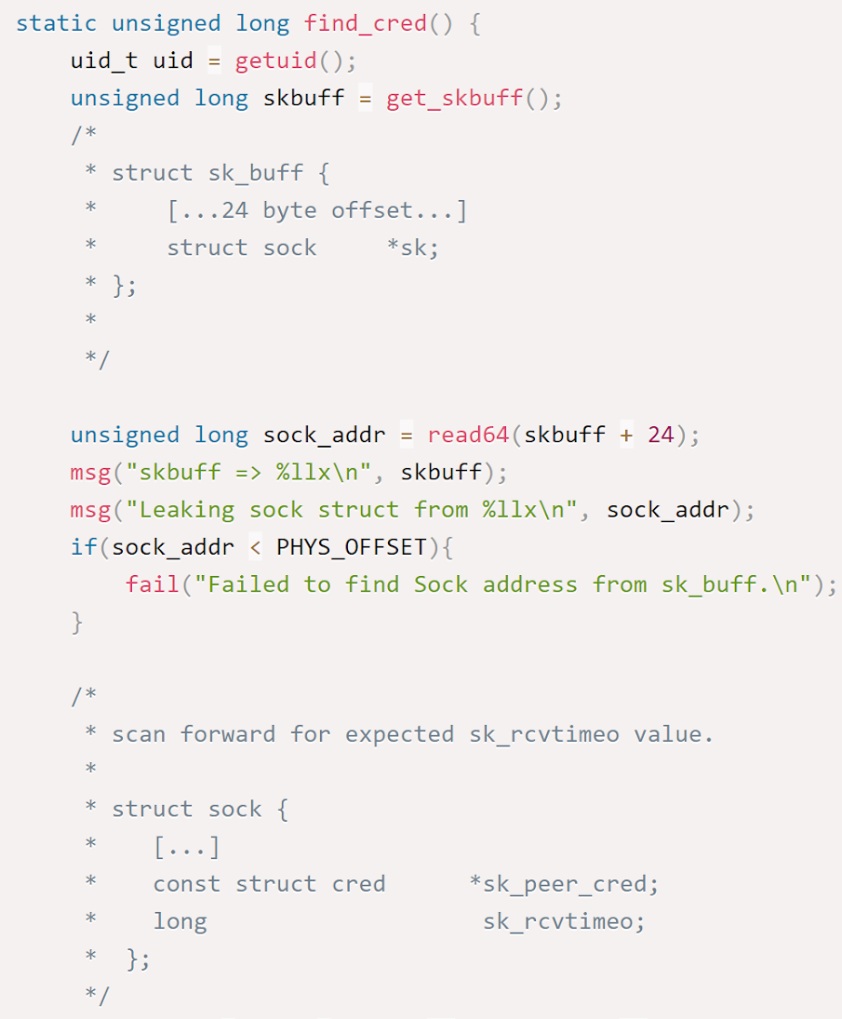
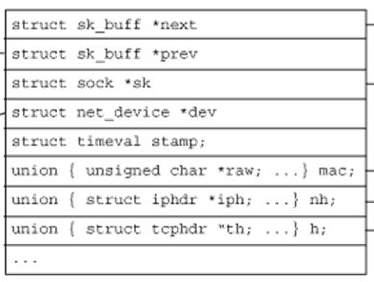
FIND_CRED()
getuid()
get_skbuff()
Notes:
Skbuff→ generic buffer for all packets
Get_skbuff() reads the address of the sk_buff structure.
Once we get the address, it’s possible to find the sock structure using an offset of 0x24 (sock_addr in our code)
Struc sock is a network layer representation of the sockets

Slide 11
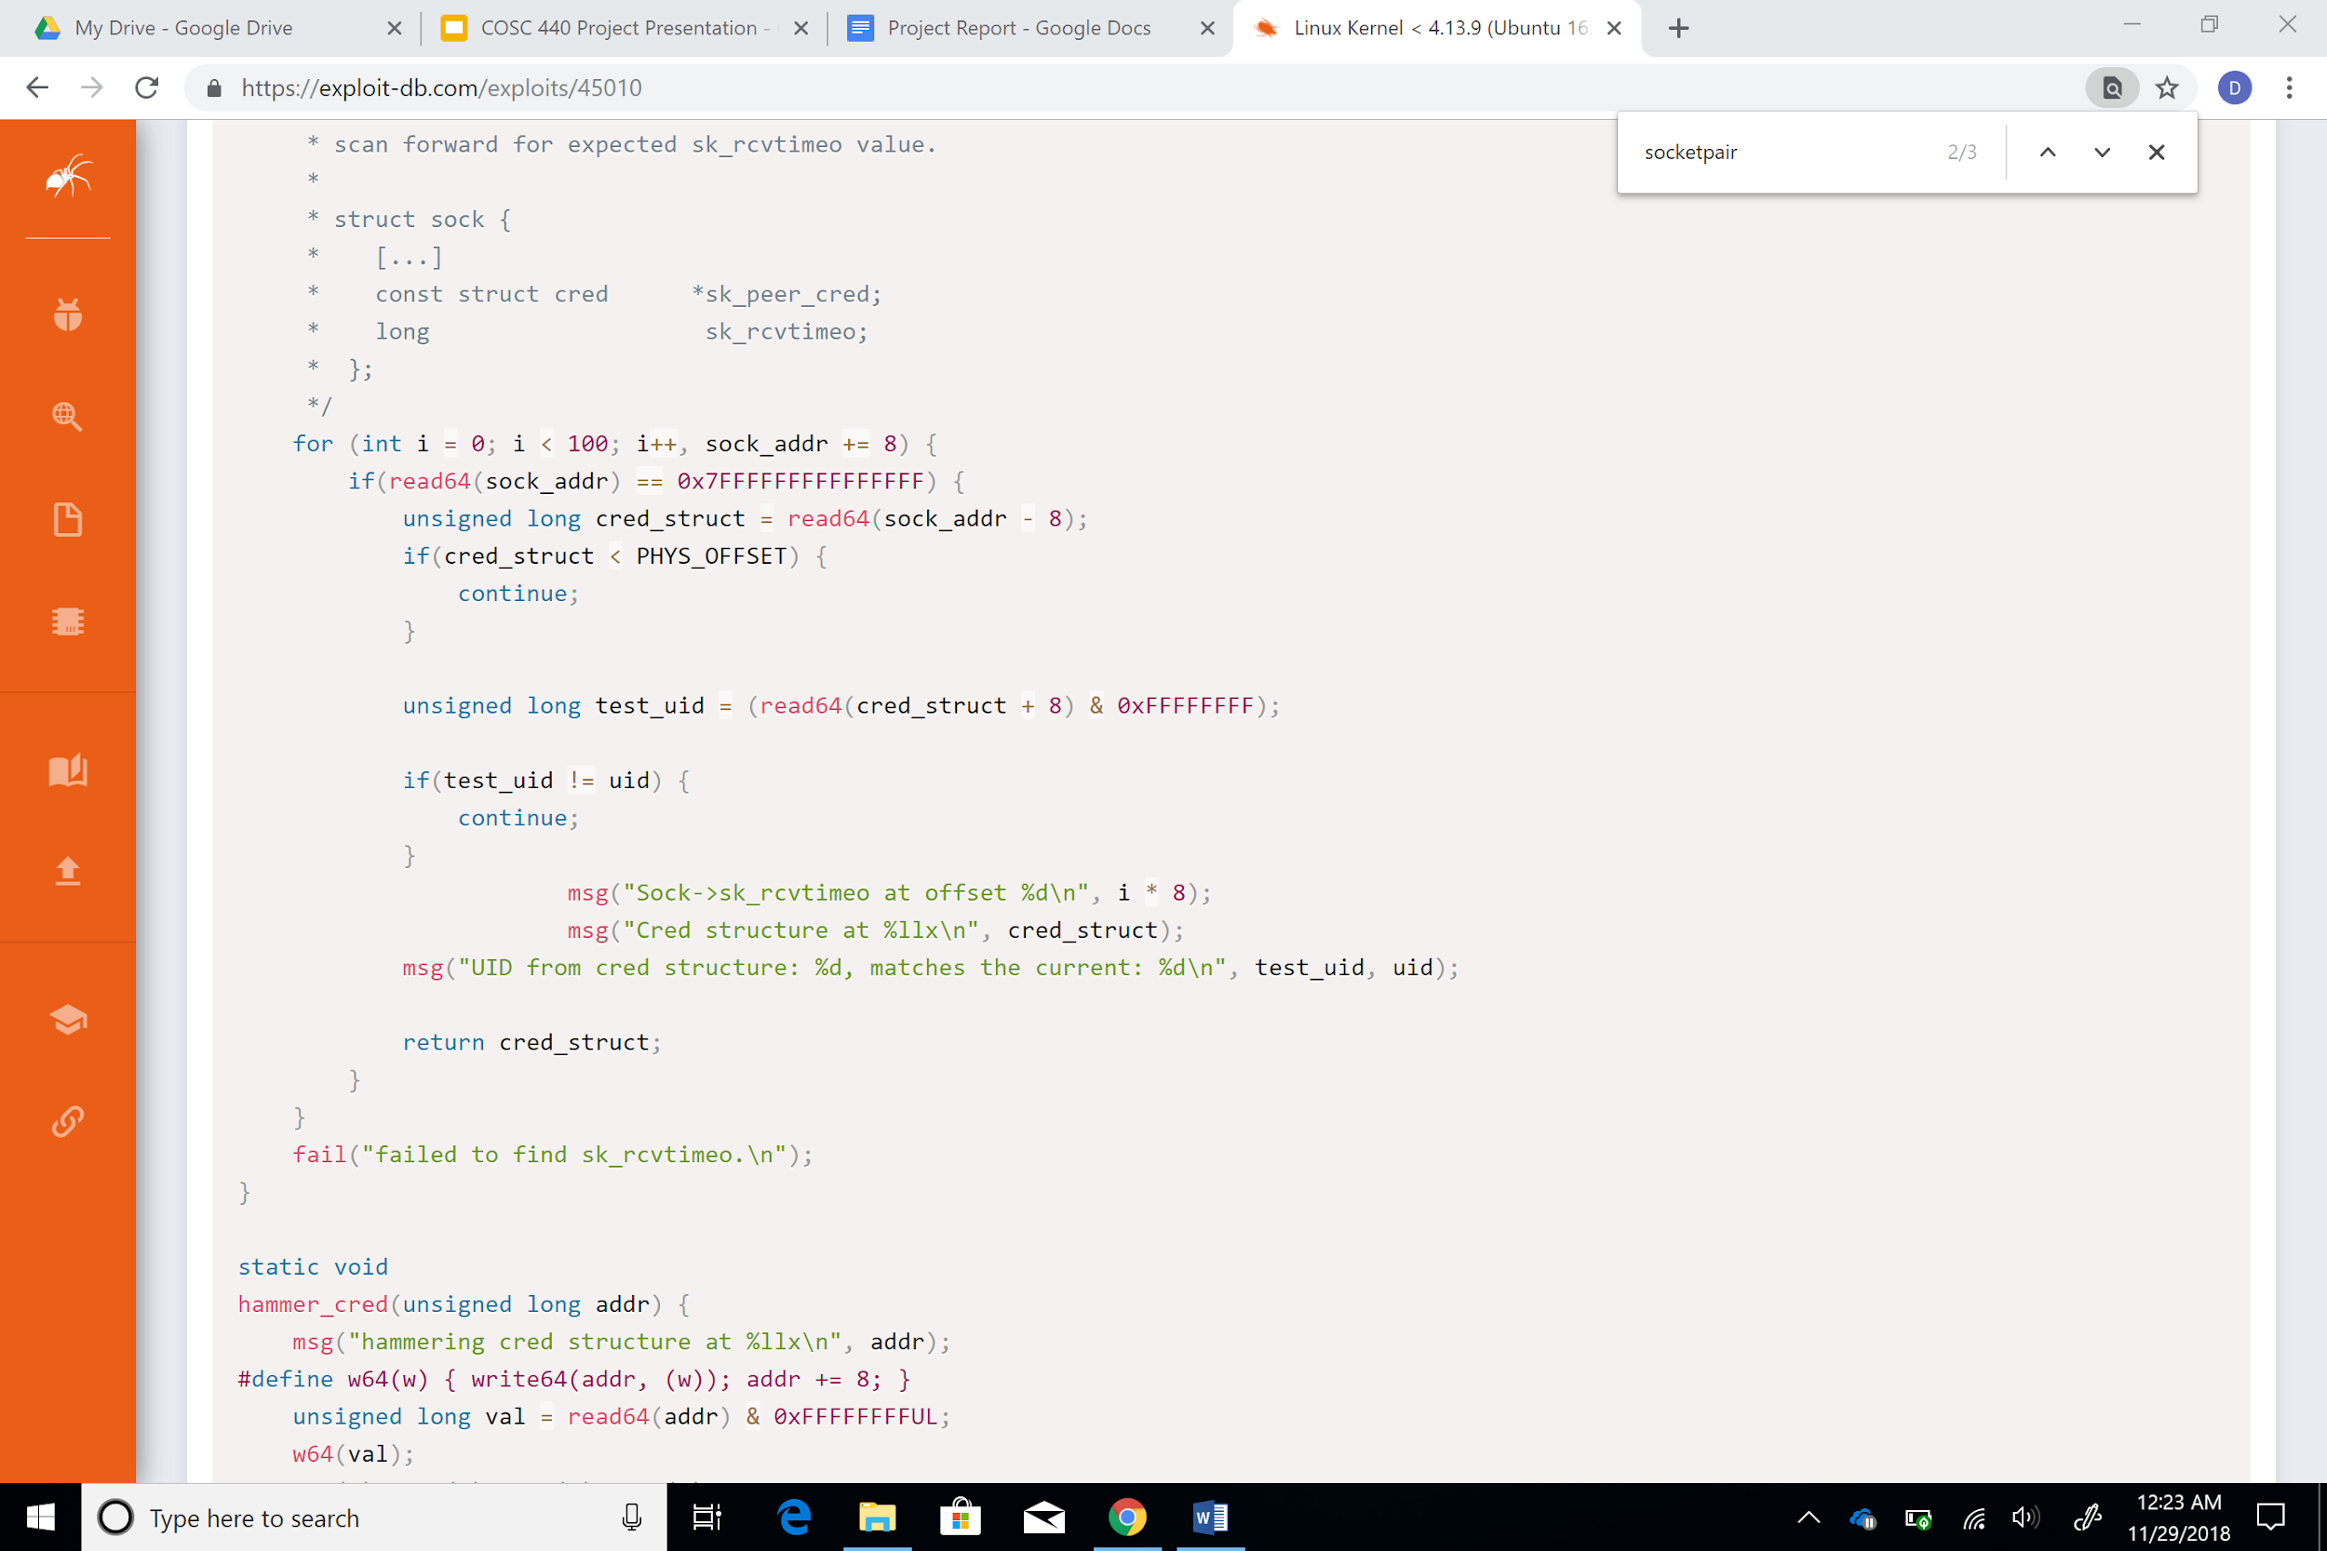
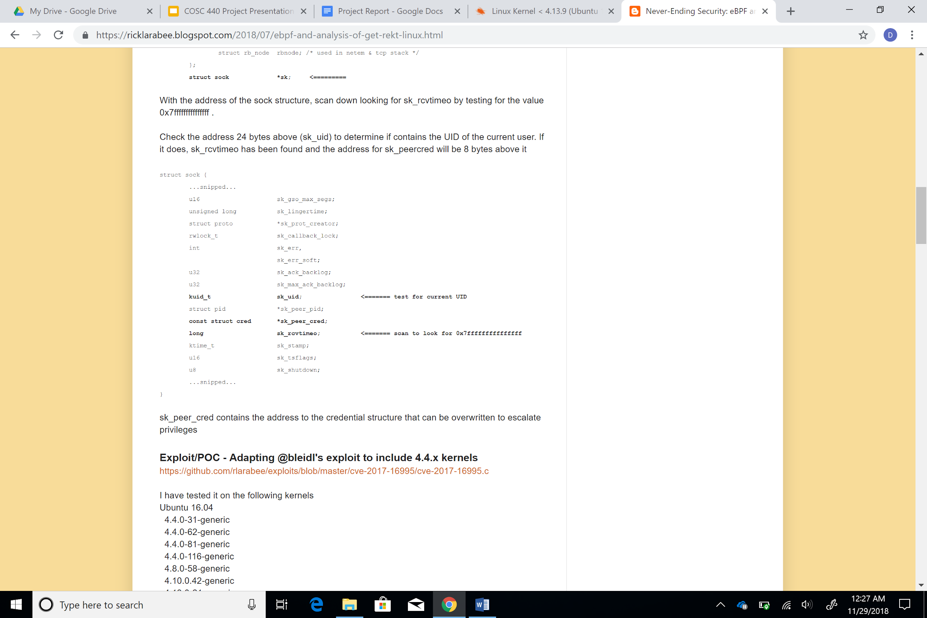
FIND_CRED()
sk_rcvtimeo 0x7FFFFFFFFFFFFFFF
sk_peer_cred-> contained address of credential structure which could be overwritten to escalate privileges
Cred_struct -> stored sk_peer_cred
Notes:
With the address of the sock structure, we scan down looking for sk_rcvtimeo by testing for the value 0x7FFFFFFFFFFFFFFF.
24 bytes above sk_rcvtimeo should be current uid of user
If it does, then sk_rcvteimeo has been found. The sk_peercred will be 8 bytes above sk_rcvtimeo.
Sk_peer_cred contains address to the credential structure that can be overwritten to escalate privileges

Slide 12
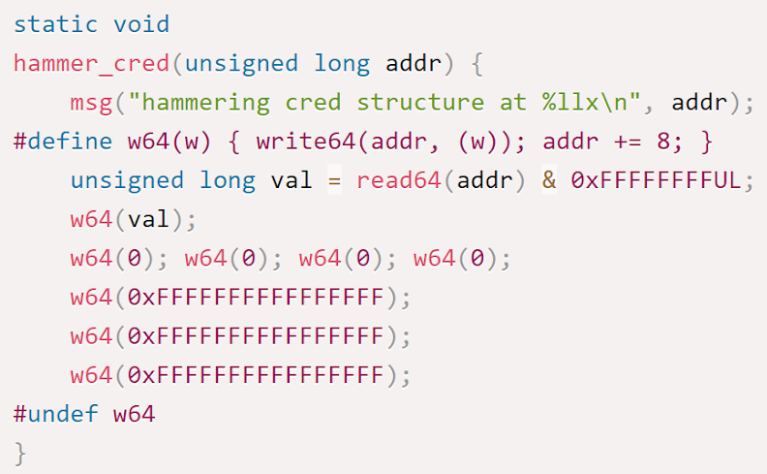
HAMMER_CRED()
addr -> cred_structure
w64(w) - Writes a value to an address
Overwrites cred structure, assigns 0 to UID, gains root privilege
Notes:
Trying to overwrite cred_structure here to escalate privileges.

Slide 13
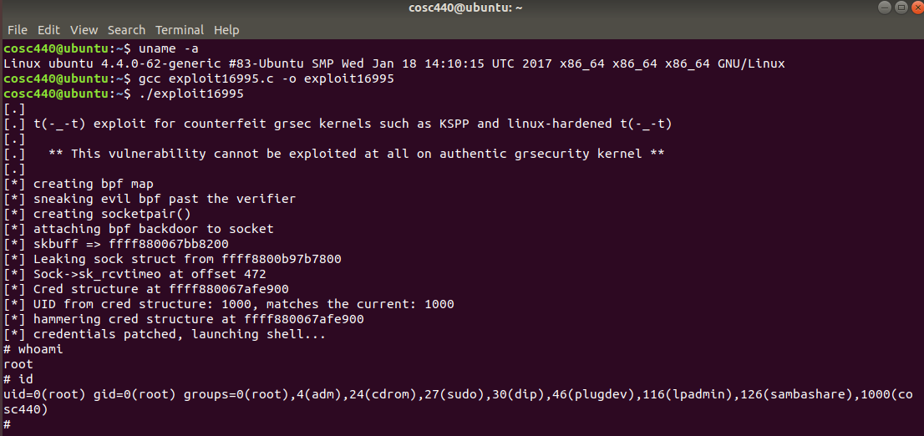

Slide 14

Demo of Exploit
Video:

Slide 15

Conclusion (How it affects CIA Triad)
Confidentiality: The attacker now has access to all of the system files.
Integrity:The entire system is compromised, there is no longer any system protection.
Availability: Once the attacker has kernel access they can make those resources completely unavailable.

Slide 16
References
[1] “CVE-2017-16995,” NVD-CVE-2017-5638. [Online]. Available: https://nvd.nist.gov/vuln/detail/CVE-2017-16995. [Accessed: 28-Nov2018].
[2] Rlarabee, “Exploit,” ExploitDBcom RSS. [Online]. Available: https://exploit-db.com/exploits/45010. [Accessed: 28-Nov-2018].
[3] “Jem’s Guide: How to compile and install a new Linux kernel,” Language in George Orwell’s Nineteen Eighty-Four (1984). [Online]. Available: http://www.berkes.ca/guides/linus_kernel.html. [Accessed: 28-Nov-2018].
[4] M. Cherny, “eBPF Vulnerability (CVE-2017-16995): When the Doorman Becomes the Backdoor,” Container and Cloud-Native applications Security. [Online]. Available: https://blog.aquasec.com/ebpf-vulnerability-cve-2017-16995-whenthe-doorman-becomes-the-backdoor. [Accessed: 28-Nov-2018].
[5] Dangokyo, “Analysis on CVE-2017-16995,” 氷
菓 , 24-May-2018. [Online]. Availalble: https://dangokyo.me/2018/05/24/analysis-oncve-2017-16995/. [Accessed: 28-Nov-2018].
[6] “What are BPF Maps and how are they used in stapbpf,” RHD Blog, 20-Apr-2018. [Online]. Available: https://developers.redhat.com/blog/2017/12/15/bpf-maps-usedstapbpf/. [Accessed: 29-Nov-2018].
[7] sem_wait(3) - Linux manual page. [Online]. Available: http://man7.org/linux/man-pages/man2/bpf.2.html. [Accessed: 29Nov-2018].
[8] README - kernel/git/torvalds/linux.git - Linux kernel source tree. [Online]. Available: https://git.kernel.org/pub/scm/linux/kernel/git/torvalds/linux.git/com mit/?id=95a762e2c8c942780948091f8f2a4f32fce1ac6f. [Accessed: 29-Nov-2018].

